Slide 1


Team Members: Brenda Izquierdo, Zeev Feldbeine Product Owner: David Villegas Instructor: Masoud Sadjadi
Senior Project Final Presentation Spring 2016
May 6th, 2016
Notes:
Greet your audience, thank them for attending your presentation, introduce yourself, introduce your project, introduce your team members, and quickly indicate what each of you did in a high-level manner, and put more emphasis on your part/contribution.

Slide 2

Problem Definition
Problem 1: Shopping for a car takes a lot of time and effort; prospective buyers have to do a lot of research to find the type of car they want.
Problem 2: Selling cars has been made easier than ever thanks to the Internet, however it is still difficult to reach prospective buyers.
Time Consuming
Expensive
Inefficient
Notes:
Introduce the problem that the whole project tackles and stay focused on the parts that you have been working. Indicate if there is an existing previous system, enumerate its problems/limitations, etc.

Slide 3
Problem Definition (cont.)
Whole Project: The Car Recommendation System(CRS) is a social web application that provides services such as buying, selling and recommending cars based on user behavior.
My Part:
UX/UI: Logo, background, web content design.
Front-End/Back-End: REST API calls, JSON parsing, system logic, seller-buyer email communication, user data and inventory display.
Authentication: Account creation and verification, password reset.
Database Administration: Create and manage collections. Insert , query and modify documents. Work with external databases.

Slide 4
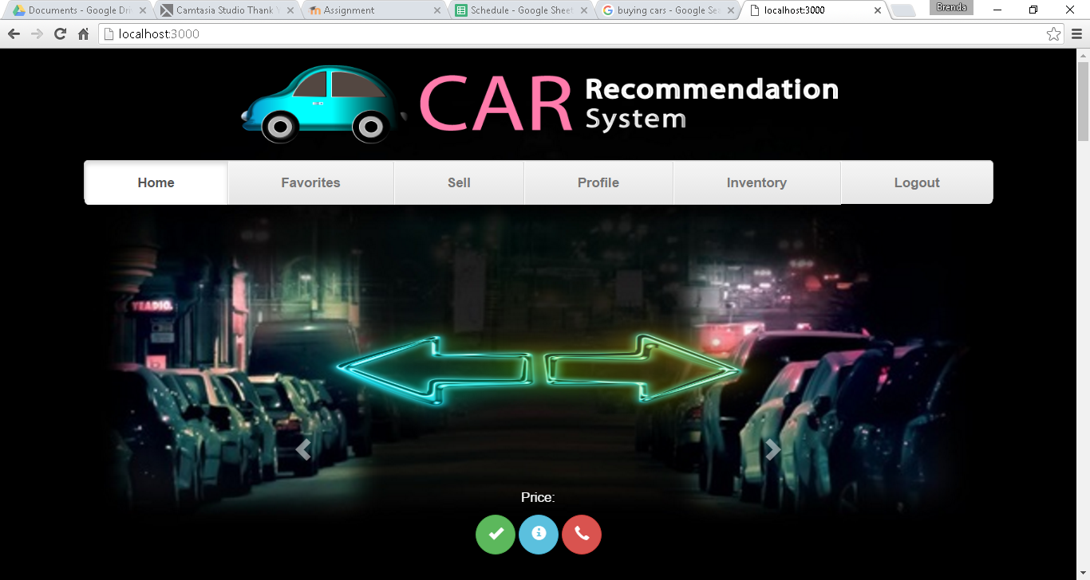

Slide 5
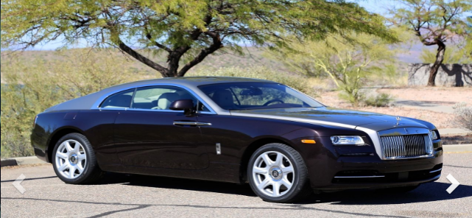

Slide 6
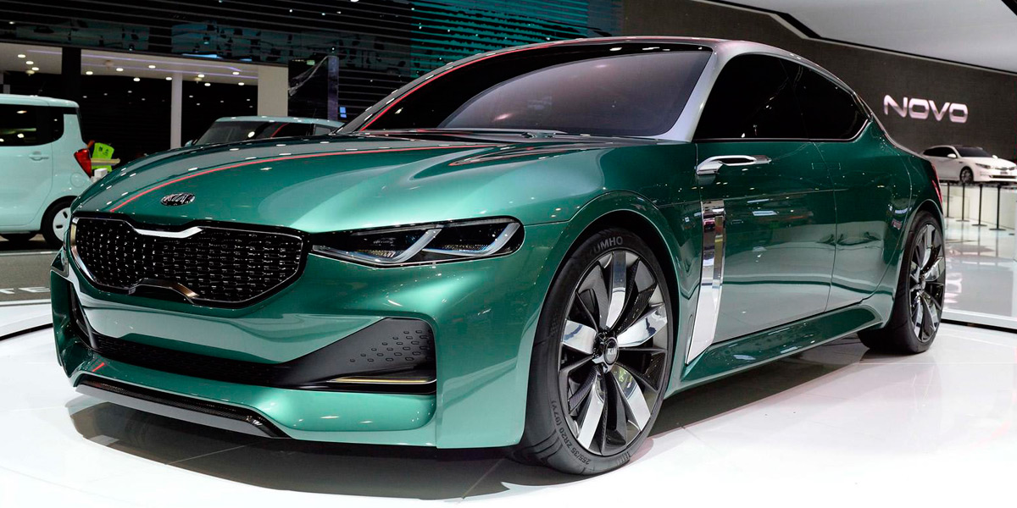

Slide 7
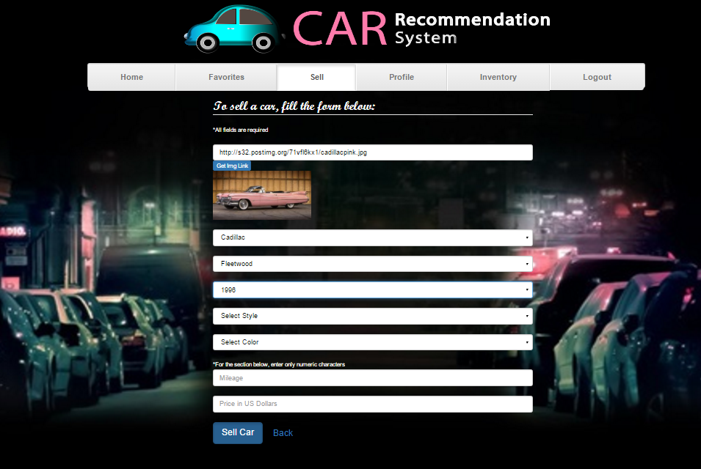

Slide 8
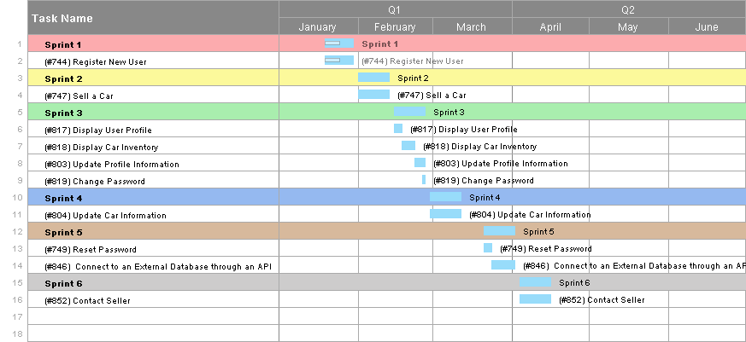
Project Management
Notes:
Project Management (schedule for entire semester) (one slide; Gantt Chart).

Slide 9
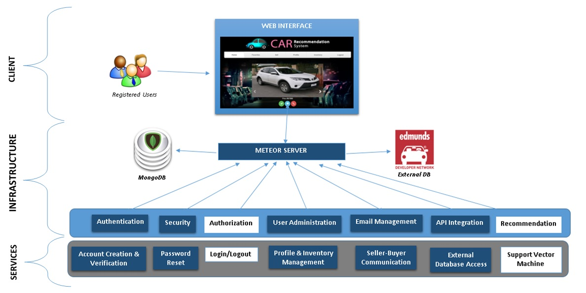
System Design: Architecture
Notes:
5. System design:
5.1. System decomposition; identify the architecture patterns used (one slide).
5.2. System deployment – h/w and s/w requirements (one slide).
5.3. Persistent data design (one slide).
5.4. Security/Privacy (one slide).

Slide 10
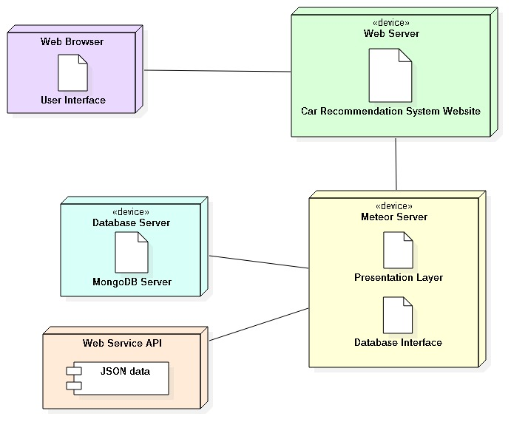
System Design: Deployment
Notes:
5. System design:
5.1. System decomposition; identify the architecture patterns used (one slide).
5.2. System deployment – h/w and s/w requirements (one slide).
5.3. Persistent data design (one slide).
5.4. Security/Privacy (one slide).

Slide 11
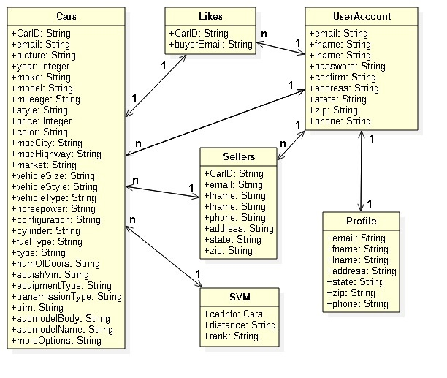
Persistent Data Design
Notes:
5. System design:
5.1. System decomposition; identify the architecture patterns used (one slide).
5.2. System deployment – h/w and s/w requirements (one slide).
5.3. Persistent data design (one slide).
5.4. Security/Privacy (one slide).

Slide 12
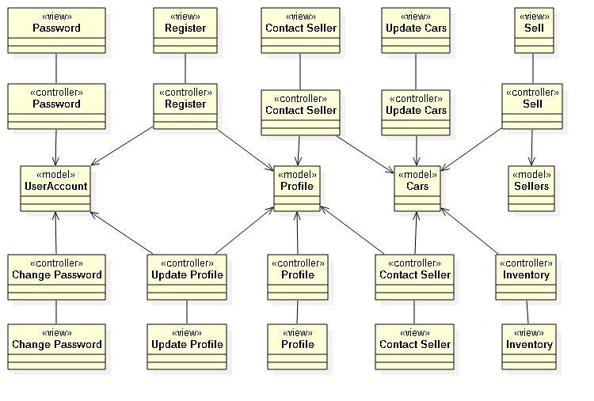
Minimal Class Diagram
Notes:
6. Detailed design:
6.1. Minimal class diagram. Identify the design patterns used (one or more slides).
6.2. State machine for the main control object or the most important object of the implemented uses cases (one or more slides).
6.3. Main algorithm used related to an implemented use case described above (one or more slides).

Slide 13
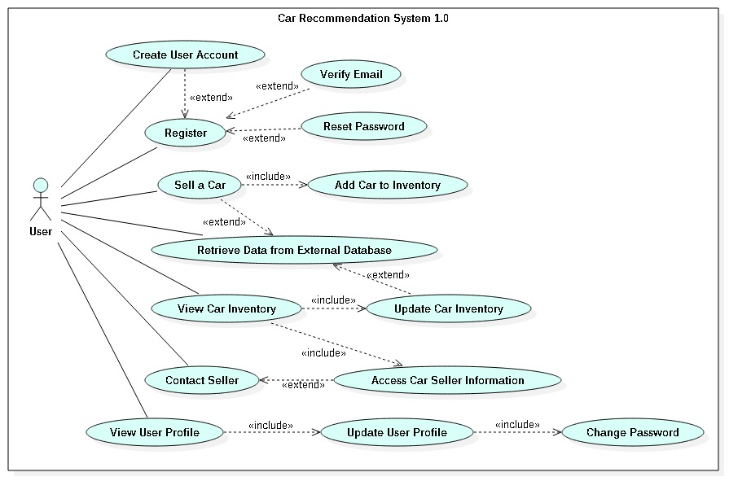
Requirements: Use Cases
Notes:
4. Requirements:
4.1. User stories implemented (one or more slides).
4.2. UML use cases and the use case diagram for the implemented use cases (one or more slides).
4.3. UML sequence diagrams for the implemented use cases.

Slide 14
Requirements: User Stories
#744: Register New User
#747: Sell a Car
#817: Display User Profile
#818: Display Car Inventory
#803: Update Profile Information
#819: Change Password
#804: Update Car Information
#749: Reset Password
#852: Contact Seller
#846: Connect to External Database Through an API
“As a seller I want to be able to retrieve all the attributes of a car based on a few ones, so I do not have to enter all of them manually.”
Notes:
4. Requirements:
4.1. User stories implemented (one or more slides).
4.2. UML use cases and the use case diagram for the implemented use cases (one or more slides).
4.3. UML sequence diagrams for the implemented use cases.

Slide 15
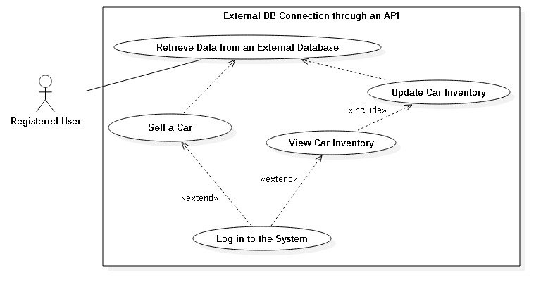
User Story #846: Use Case Diagram

Slide 16
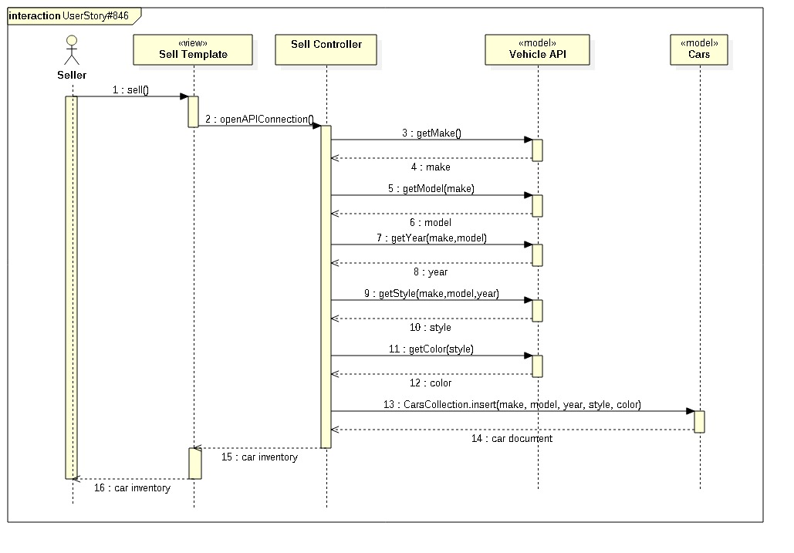
User Story #846: Sequence Diagram
Notes:
4. Requirements:
4.1. User stories implemented (one or more slides).
4.2. UML use cases and the use case diagram for the implemented use cases (one or more slides).
4.3. UML sequence diagrams for the implemented use cases.

Slide 17
User Story #846: Use Case
Actor: Seller
Pre-conditions:
System login web page has been activated and is displayed.
User is logged in to the system with valid credentials.
Description:
Use case begins when user clicks on the sell tab.
The system displays a data entry form.
User should enter the following data: a picture of the car, mileage, and price. User selects an option from the following dropdown menus: make, model, year, style, and color.
After completing the form, the user should click on the “Sell Car” button.
Once the system validates the information, the data will be stored in the Cars collection as a document.
The new car is displayed in the Inventory tab.
User can click the “Update”, “See Details” or “Delete” buttons.
Use case ends when user clicks on a different tab or logs out.

Slide 18
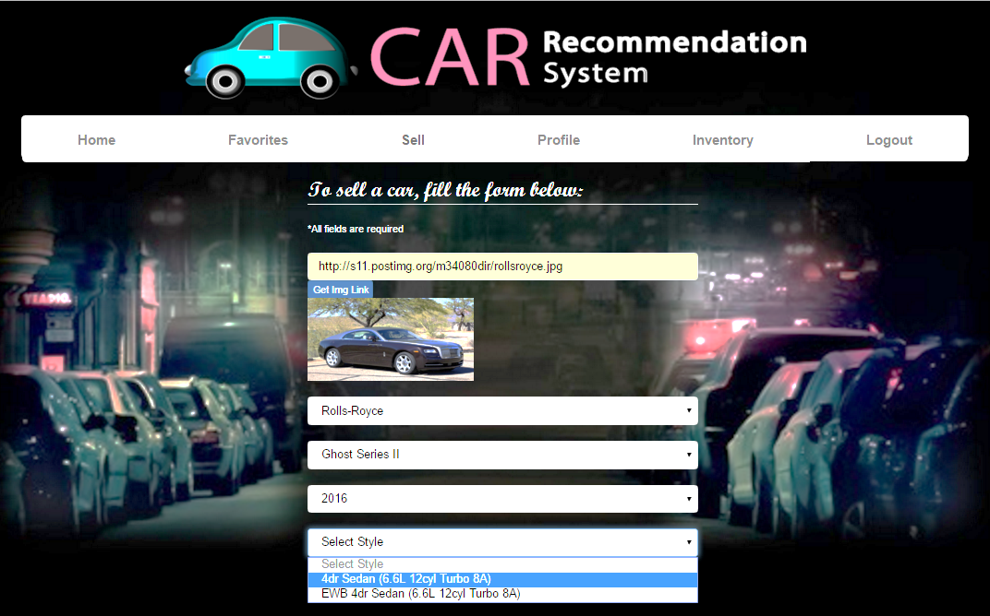
User Story #846: Use Case (cont.)
Post-conditions:
A new car is added to the Cars Collection
The new car is displayed in the Inventory tab

Slide 19

Main Algorithm
openAPIConnection()
begin
connect to Edmunds.com Vehicle API
open XMLHttpRequest ('GET', 'http://api.edmunds.com/api/vehicle/v2/makes?fmt=json&api_key={{apiKey}}), store ‘make’
open new XMLHttpRequest to getModel(‘make’), store ‘model’
open new XMLHttpRequest to getYear(‘make’, ‘model’), store ‘year’
open new XMLHttpRequest to getStyle(‘make’, ‘model’, ‘year’), store ‘style’
open new XMLHttpRequest to getColor(‘style’), store ‘color’
CarsCollection.insert(‘make’, ‘model’, ‘year’, ‘style’, ‘color’)
end
Notes:
6. Detailed design:
6.1. Minimal class diagram. Identify the design patterns used (one or more slides).
6.2. State machine for the main control object or the most important object of the implemented uses cases (one or more slides).
6.3. Main algorithm used related to an implemented use case described above (one or more slides).

Slide 20
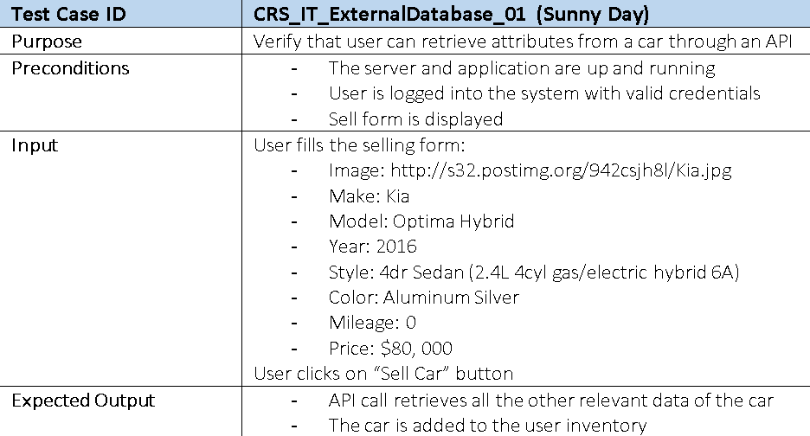
Test Case: Sunny Day
Notes:
7. Test Suites and Test Cases (one sunny day and one rainy day) for the use case represented in part (5) above (2 slides).
7.1 One sunny day and one rainy day for the implemented use cases (one or more slides).
7.2 Automated test scripts for the implemented use cases (one or more slides).

Slide 21
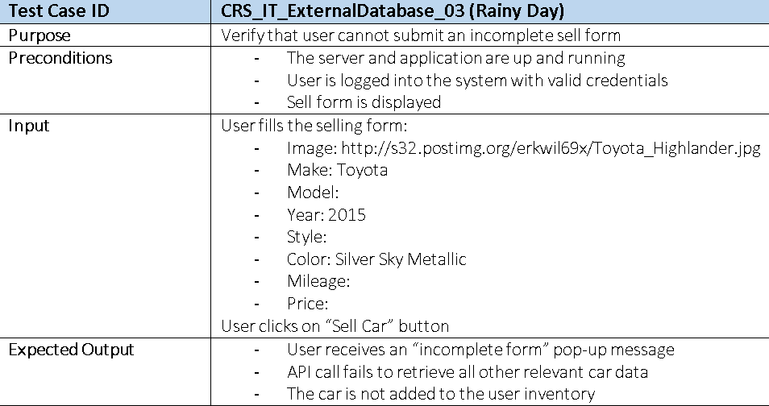
Test Case: Rainy Day

Slide 22
Summary
The Car Recommendation System is a website that helps users find the perfect car by constantly recommending a best match based on their preferences. It also allows users to sell their cars as well.
My work in the project involves the registration, car sale, seller-buyer communication, and profile and inventory management features.
Contact information: bizqu002@fiu.edu
Thank you!
Notes:
Summarize your contribution
Include your contact information
Ask if anyone has any questions for you.
Thank your audience

